Slide 1

UM – Game-Playing Strength of MCTS Variants
Predict which variants of Monte-Carlo Tree Search will perform well or poorly against each other in hundreds of board games
Team Kwak’s Potatoes
강태영, 김준형, 김현동, 이나현, 이은승

Slide 2
CONTENTS
PART
01
Introduction
Introduction to the competition
PART
04
Our Model
Target variables and what to consider
현동’s PCA
태영’s CatBoost
나현‘s XGBoost
PART
02
Data EDA & Preprocessing
Data Analysis
Data preprocessing
PART
05
Conclusion
Public Score
PART
Methodology
Development
03
References & Discussion
Design our own method

Slide 3
PART
01
Introduction
Introduction to the competition
Target variables and what to consider
연구배경
연구 목적 및 흐름도

Slide 4
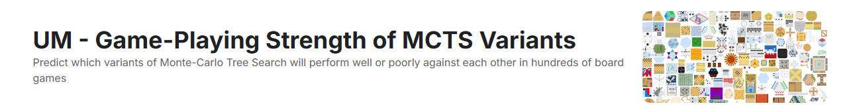


PART 1 Introduction
Part 1
01 . Introduction to the competition
연구 개요
1
Kaggle competition
유형 분류를 통해 다양한 사고에 대한 정리 및 해결책을 제시
이를 활용해 자율주행차량 안전성 향상 및 도입화 가속
2
MCTS?
MCTS?
A search algorithm used to
develop intelligent
board game players.
EX) AlphaGo
Researchers have developed various MCTS variants for games but haven't identified the best fit for specific game types.
This competition focuses on finding MCTS variants that perform well across diverse scenarios.
The goal is to create a model that predicts how one MCTS variant performs compared to another in different games.

Slide 5
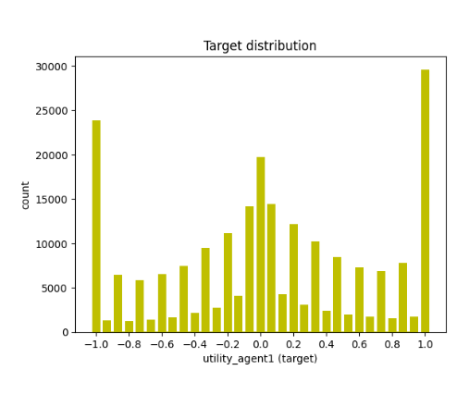



PART 1 Introduction
Part 1
02 . The goal of the competition
연구 개요
1
Goal & Evaluation
Goal:
To predict agent 1's performance against agent 2(Regression Problem)
Evaluation:
The root mean square error(RMSE) between the actual performance level value of agent 1 and the performance level of agent 1 we predicted.
2
Target variable
The "utility_agent1" variable
<Target variable plot>
- How successful agent 1 was & How failed it was
- The difference in performance between two players
Agent 1 is dominant
(utility_agent1 > 0)
Agent 1 is equivalent
(utility_agent1 = 0)
Agent 1 is defeat
(utility_agent1 < 0)

Slide 6
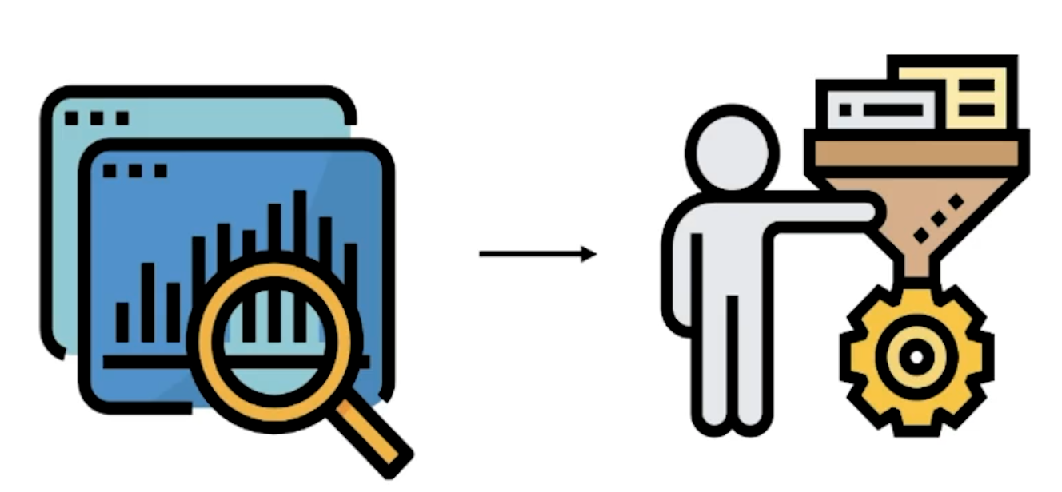
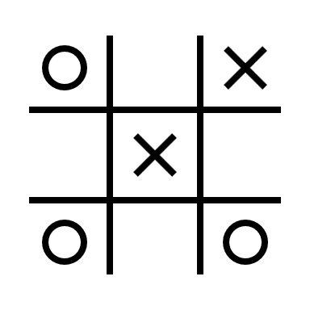



PART 1 Introduction
Part 1
03 . Things to Consider in the Competition
연구 개요
1
Things to consider
1. Don't just rely on certain games
2. The amount of very large data
<Train data>
<Test data>
The test data consists of new games
not observed in the training data.
It's important which column you drop well and what derivative you generated.
Choosing meaningful variables with data EDA and preprocessing is very important!
Notes:
대회 시작 전 토론이 활발했음-> discussion 부분 읽고 -> 실제 팀원들과 discussion 많이함

Slide 7
PART
02
Data EDA & Preprocessing
Data Analysis
Data preprocessing
연구배경
연구 목적 및 흐름도

Slide 8
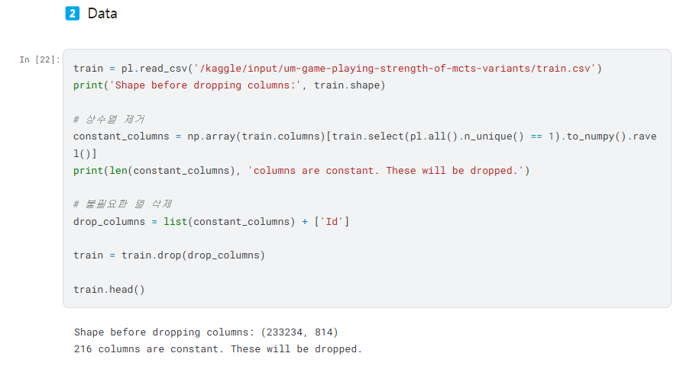
PART 2 Data EDA & Preprocessing
Part 1
01 . Data Analysis
연구 개요
1
Data Basic Structure
Basic training data provided in the problem : (233234, 814)
Remove constant columns and unnecessary columns

Slide 9
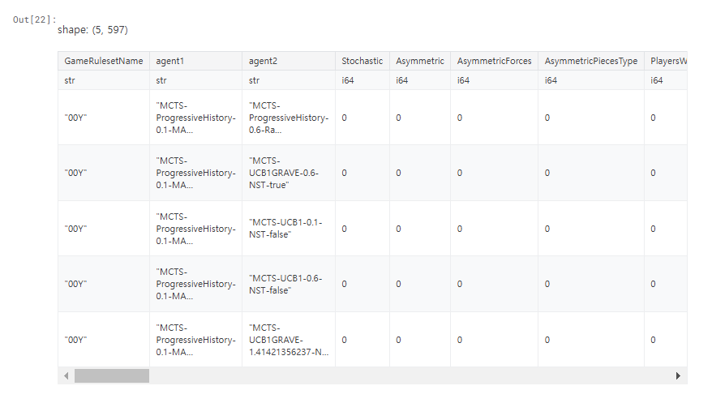
PART 2 Data EDA & Preprocessing
Part 1
01 . Data Analysis
연구 개요
1
Data Basic Structure
Remove constant and unnecessary columns (ex. Id) : (233234, 597)
<597 column configurations>
1. 5 string colums:
GameRulesetName, agent1, agent2, EnglishRules, LudRules
Continuous value columns
ex. utility_agent1
(3 of these are binary)
2. 183 Float64 columns:
3. 409 Int64 columns:
integer value columns
ex. num_wins_agent1
(379 of these are binary)

Slide 10
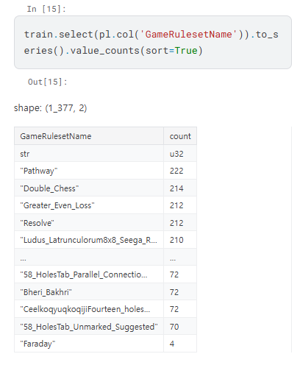
PART 2 Data EDA & Preprocessing
Part 1
01 . Data Analysis
연구 개요
1
Data Basic Structure
-’GameRulesName’ variable
This variable represents various board game rule names.
There may be values that are not included in the test data,
so do not use them as features
Use when grouping in GroupKFold =>
Minimize the impact of specific games on model performance

Slide 11
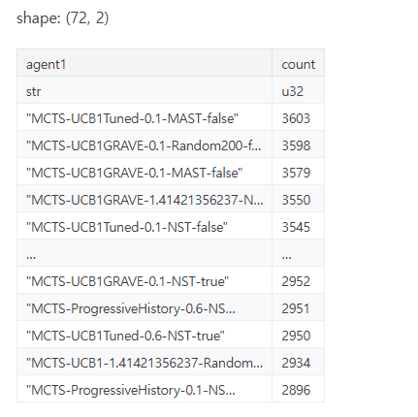
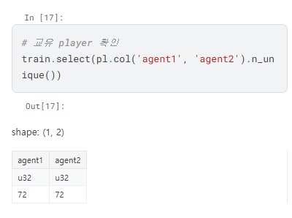
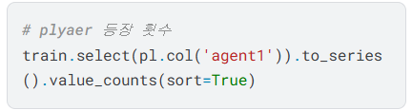
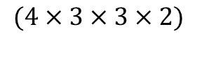
PART 2 Data EDA & Preprocessing
Part 1
01 . Data Analysis
연구 개요
1
Data Basic Structure
: The settings used in the MCTS algorithm
-Player variable
MCTS-<SELECTION>-<EXPLORATION_CONST>-<PLAYOUT>-<SCORE_BOUNDS>
<SELECTION>: Selective Policy
<EXPLORATION_CONST>: A constant of exploration
<PLAYOUT>: Simulation method
<SCORE_BOUNDS>: A way of calculating scores
-Number of possible combinations of each feature: 72
$$(4×3×3×2)$$

Slide 12
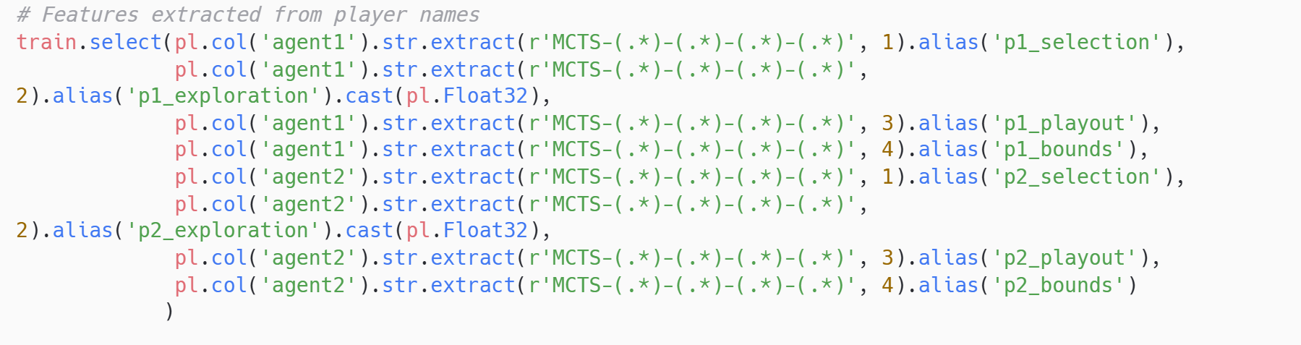
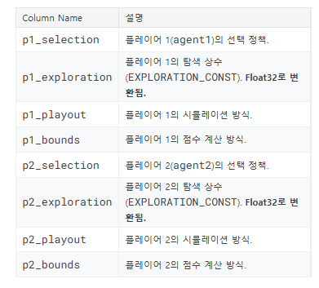
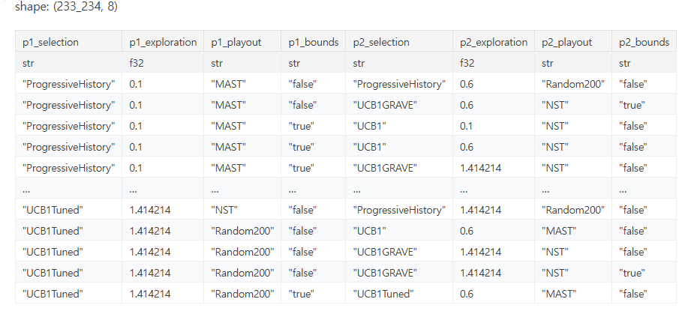
PART 2 Data EDA & Preprocessing
Part 1
01 . Data Analysis
연구 개요
1
Data Basic Structure
-Player variable
Result of Code:
“New Feature Column”
Extracted from the player names
(agent1 and agent2) to create
a new column

Slide 13
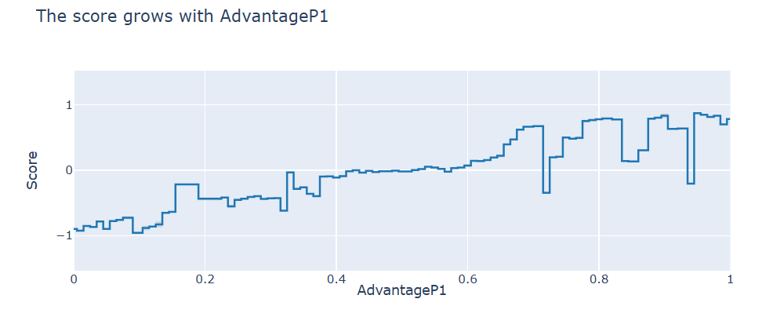
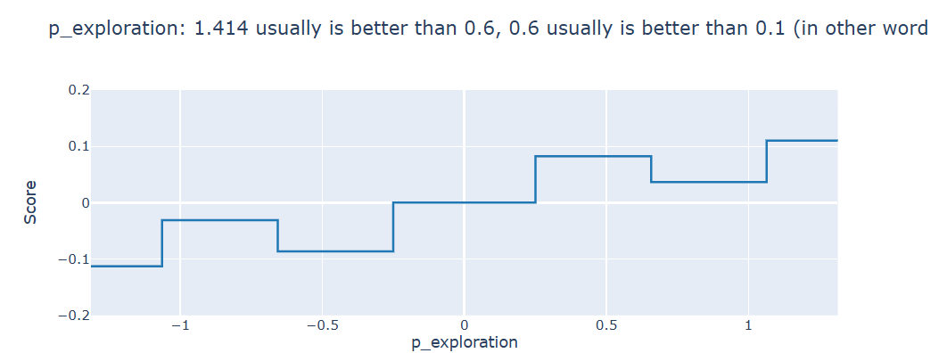
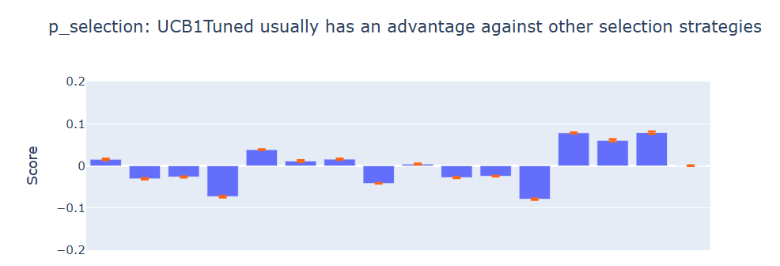
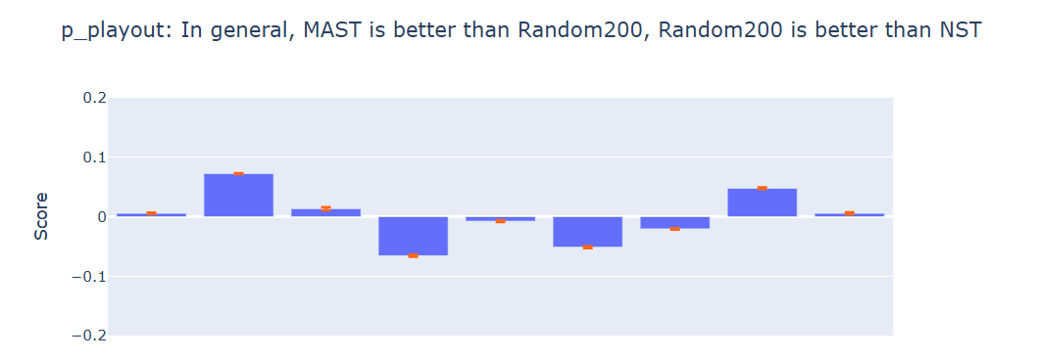
PART 2 Data EDA & Preprocessing
Part 1
01 . Data Analysis
연구 개요
2
Data EDA
Trend of change in target value
with increasing/decreasing Advantage P1 value
Trend of change in target value with p_exploration
Larger values provide better results
The effect of a player's MCTS strategic element (selection, playout) on the target value

Slide 14
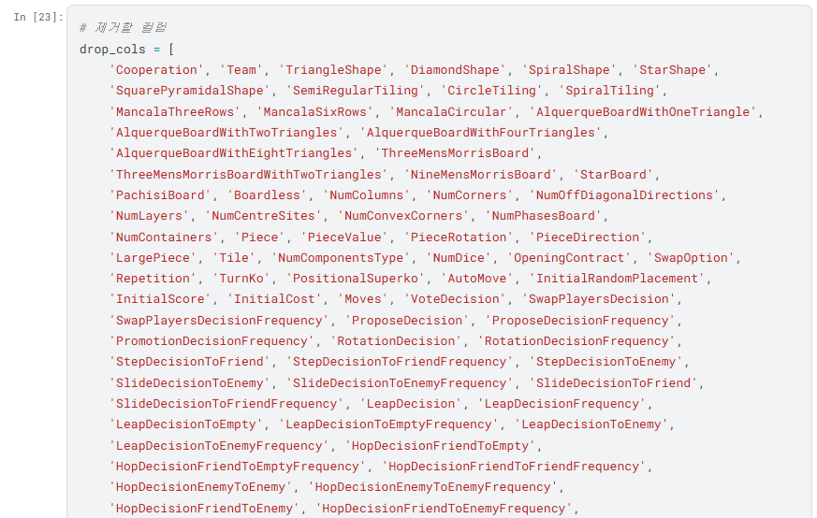
PART 2 Data EDA & Preprocessing
Part 1
02 . Data Preprocessing
연구 개요
1
Drop Columns
1. Data with unclear or noisy meaning
ex) shape, tiling, component, and color
not directly related to the results of the game
2. Deduplication
ex) drama, dramaAverage, dramaMedian
Remove only one to prevent overfitting
3. Only apply to certain types of games or styles
ex) ChesComponent, MancalaStyle,
JanggiComponent

Slide 15
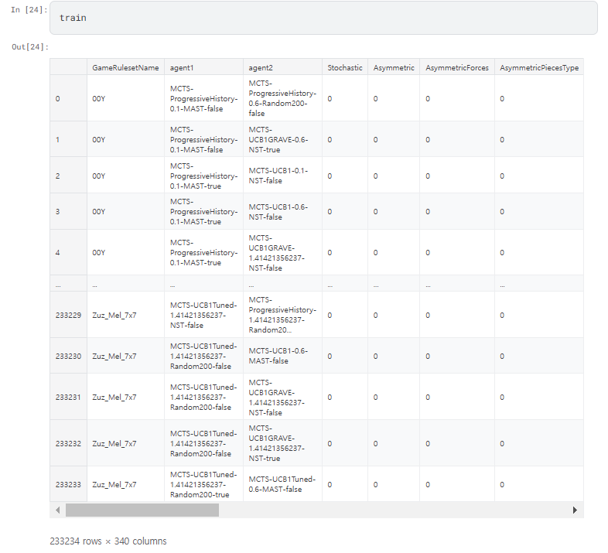
PART 2 Data EDA & Preprocessing
Part 1
02 . Data Preprocessing
연구 개요
1
Drop Columns
Final train data after
unneeded columns are removed
(233324, 340)

Slide 16
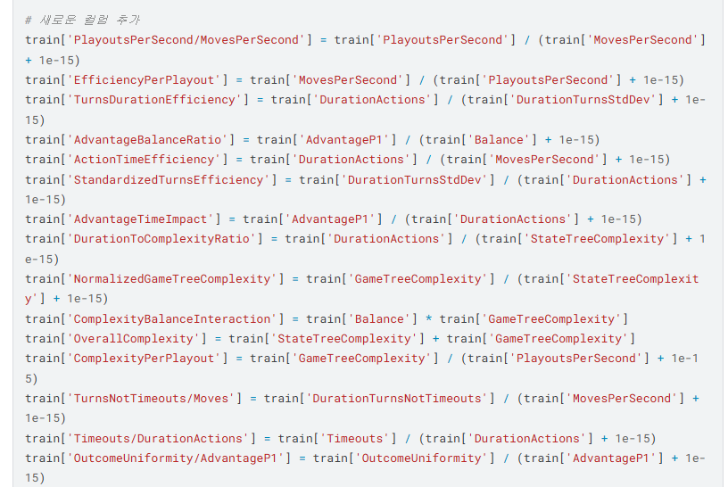
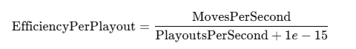
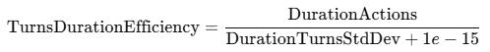
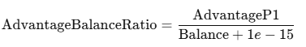
PART 2 Data EDA & Preprocessing
Part 1
02 . Data Preprocessing
연구 개요
2
Derivative Variables
<Create a new derivative>
1. EfficencyPerPlayout
2. TurnsDurationEfficiency
3. AdvantageBalanceRatio
Create a derivative variables with reference to the Discussion part

Slide 17
PART
03
Methodology
References & Discussion
Design our own method
연구배경

Slide 18
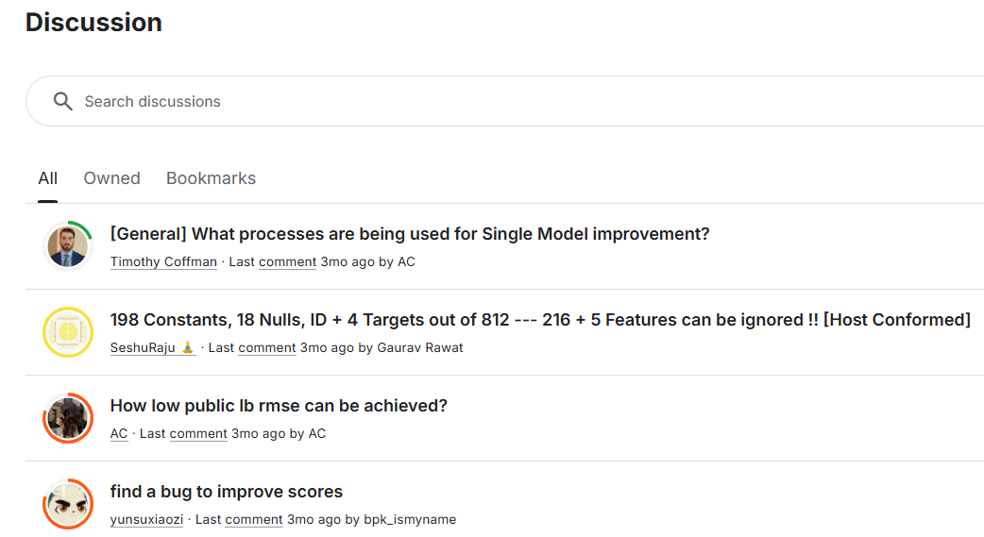
PART 3 Methodology
Part 1
01. References
연구 개요
1
Discussion
Baseline Model in Discussion
By default, analyze the feature importance of the model based on preprocessed training data
Gradient Boosting model learning with feature selection is an effective way to achieve both performance improvement and computational efficiency
Increase the likelihood of interpreting model results and provide a clearer understanding of the core patterns of the data
It is good to use the Gradient Boosting model with Feature Selection

Slide 19
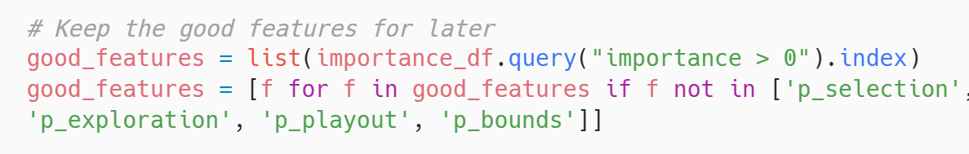
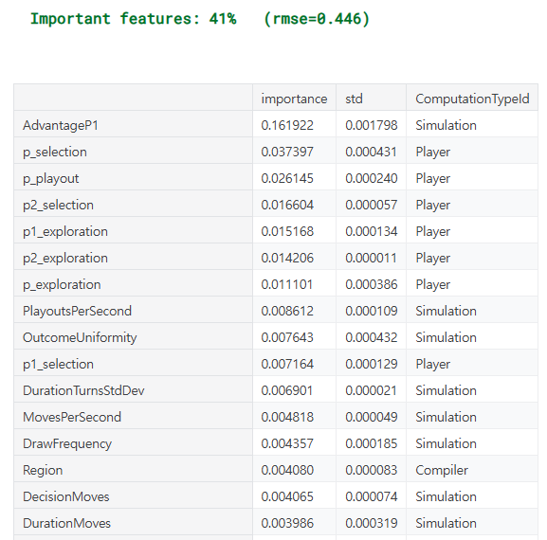
PART 3 Methodology
Part 1
01. References
연구 개요
1
Discussion
Important Features
In this model, only 30% to 40% of the features
are significant, and the rest are not useful.
The most important feature is ‘AdvantageP1’
The element of the player variable, which was the main variable introduced earlier,
was selected as an important feature

Slide 20
PART 3 Methodology
Part 1
02. Design our own method
연구 개요
1
Modeling strategy
Gradient Boosting
3
Concept:
Combines weak learners (e.g., decision trees) sequentially to build a strong predictive model.
Each new model focuses on reducing the residuals (errors) of the previous models.
Strengths:
Nonlinear Relationship Learning: Captures complex, nonlinear patterns in data.
Iterative Error Reduction: Each model improves the overall accuracy by reducing prior errors.
How it Works:
Train the first model and compute residuals.
Train subsequent models to minimize these residuals.
Combine predictions of all models for the final output.

Slide 21
PART 3 Methodology
Part 1
02. Design our own method
연구 개요
2
Model to utilize
Most Common Library:
Lightgbm
XGBoost
CatBoost
Machine Learning Techniques Learned in Class & Use the above models as well

Slide 22
PART
04
Our Model
현동’s PCA
태영’s CatBoost
연구배경
나현‘s XGBoost

Slide 23
PART 4 Our Model
Part 1
01. 현동’s PCA
연구 개요
1
Modeling Strategy
PCA
A technique for reducing dimensions while retaining maximum variance in data.
- How it Works
Standardize data → Compute covariance matrix → Find eigenvalues/vectors → Project onto principal components.
- Why use PCA?
Dimensionality Reduction: Simplifies data while retaining key patterns.
Efficiency: Speeds up computation by reducing dimensions.
Noise Reduction: Removes irrelevant data, enhancing performance.
Visualization: Projects data into 2D/3D for better insights.

Slide 24
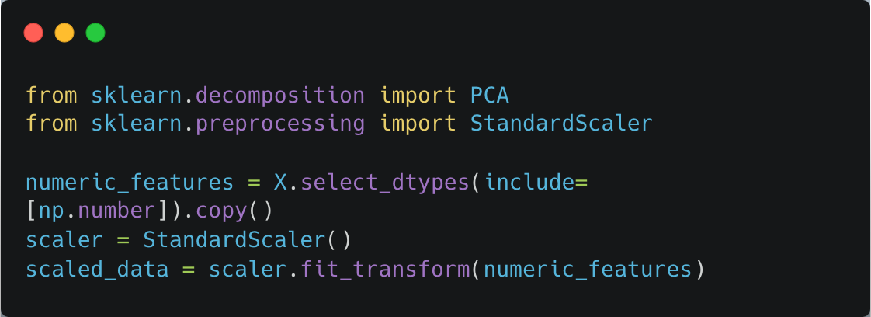
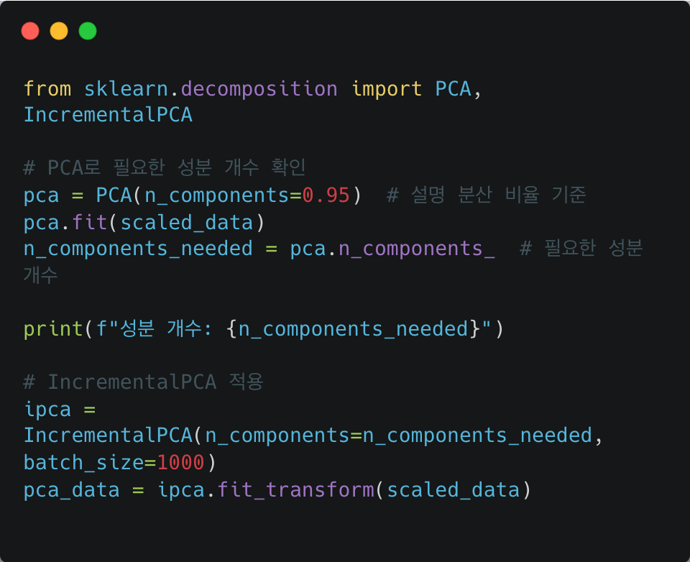
PART 4 Our Model
Part 1
01. 현동’s PCA
연구 개요
2
Model Codes
PCA
Processes the entire dataset at once, which can be memory-intensive.
Suitable for small to medium-sized datasets.
Incremental PCA
Processes data in batches, making it more memory-efficient
and ideal for large datasets.
batch_size=1000 was set, processing 1,000 rows of data at a time.
224 components are needed to explain 95% of the variance.

Slide 25
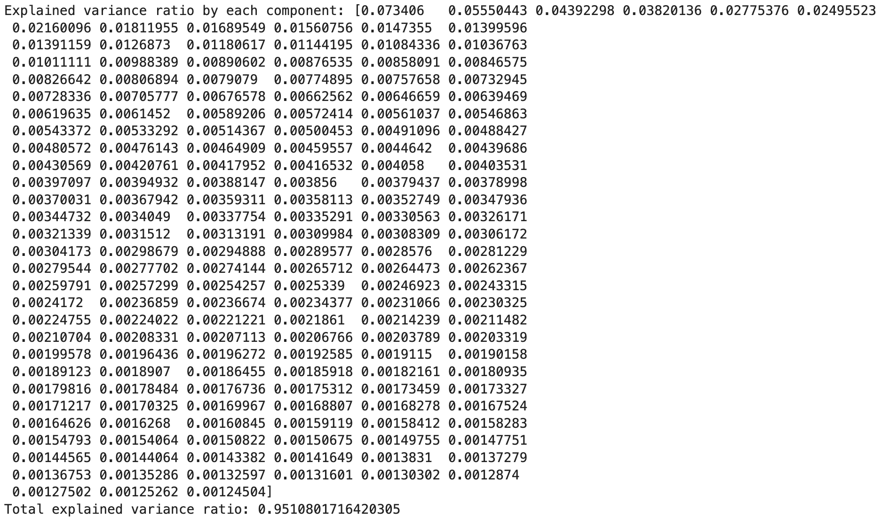
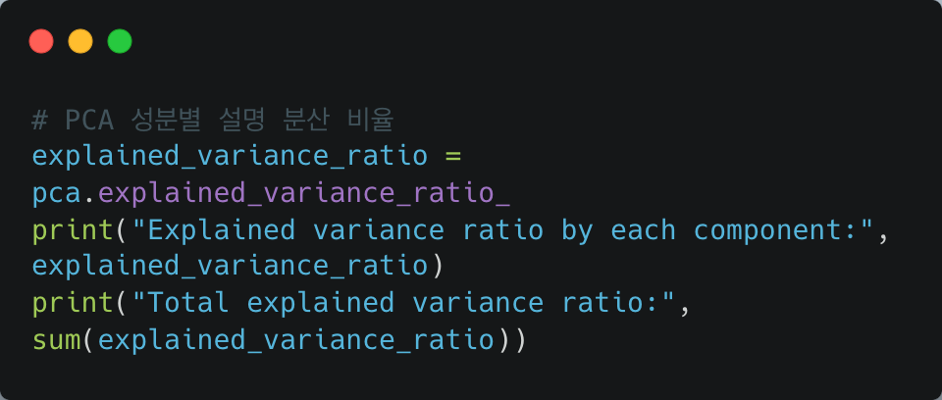
PART 4 Our Model
Part 1
01. 현동’s PCA
연구 개요
3
Results
Explained Variance: The principal components collectively explain 95.11% of the total variance in the dataset.
Significance : The most of the important information in the data is preserved while reducing its dimensionality.
25

Slide 26
PART 4 Our Model
Part 1
02. 태영’s CatBoost
연구 개요
1
Modeling Strategy
CatBoost
-What is CatBoost?
CatBoost is a type of Gradient Boosting algorithm designed to handle categorical data efficiently.
It provides automatic encoding for categorical variables and delivers high predictive accuracy.
-Why CatBoost for this dataset?
The dataset contains many categorical features, making CatBoost ideal for leveraging its
categorical data handling capabilities.

Slide 27
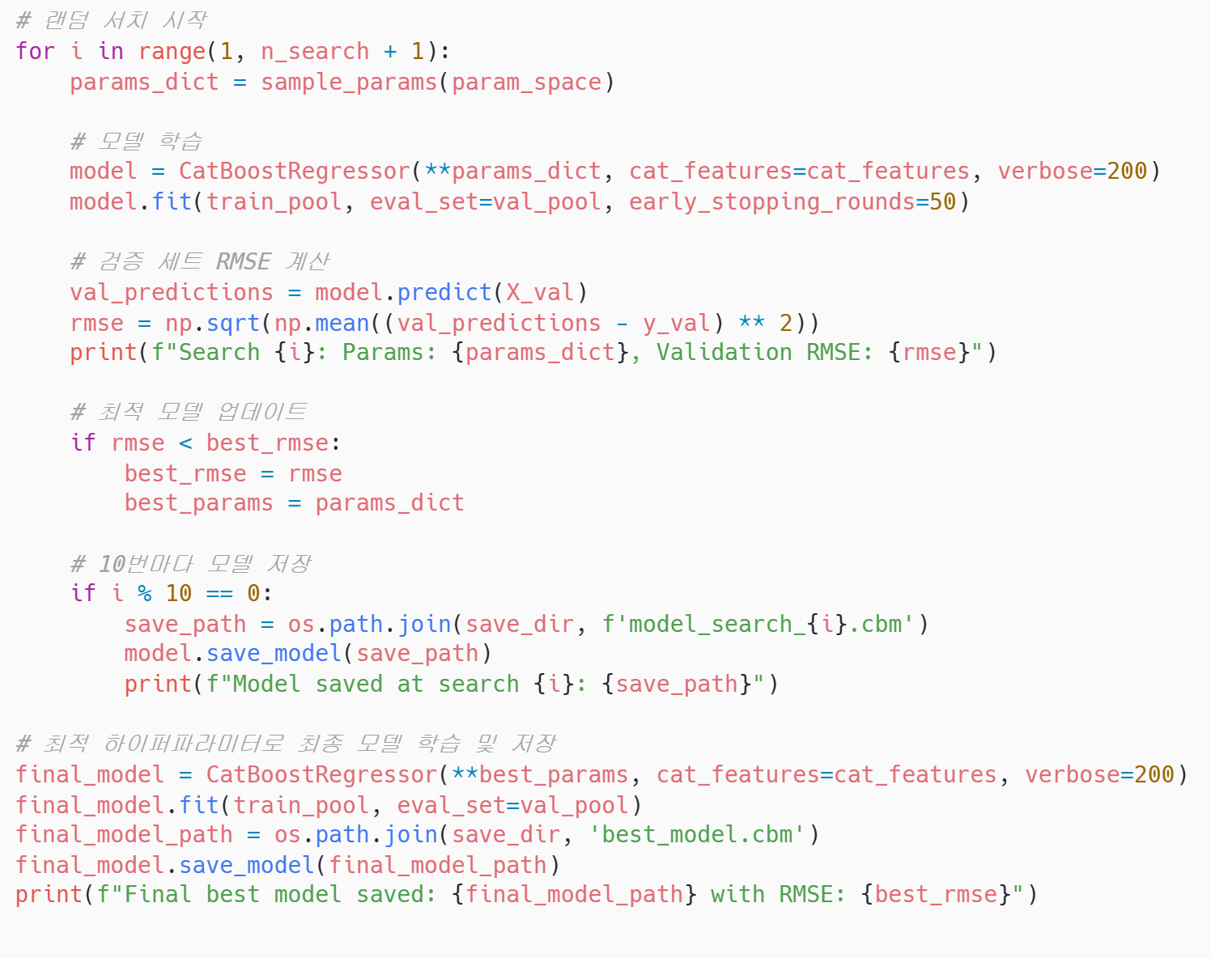
PART 4 Our Model
Part 1
02. 태영’s CatBoost
연구 개요
2
Model code
CatBoost
Proceed with Feature Selection with catboost base model
2. Reduce features through
Feature Selection > 0
3. Proceed to RS 100 and RS 200
→ Submission after RS200

Slide 28
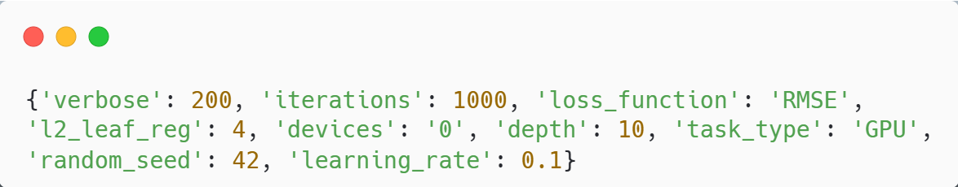
PART 4 Our Model
Part 1
02. 태영’s CatBoost
연구 개요
3
Results
CatBoost
Proceed with Feature Selection with catboost base model
2. Reduce features through
Feature Selection > 0
3. Proceed to RS 100 and RS 200
→ Submission after RS200
“Random Search Results”

Slide 29
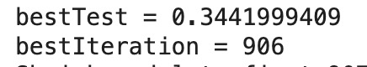
PART 4 Our Model
Part 1
02. 태영’s CatBoost
연구 개요
3
Results
CatBoost
Proceed with Feature Selection with catboost base model
2. Reduce features through
Feature Selection > 0
3. Proceed to RS 100 and RS 200
→ Submission after RS200

Slide 30
PART 4 Our Model
Part 1
03. 나현’s XGBoost
연구 개요
1
Modeling strategy
XGBoost
LightGBM
“Advanced Gradient Boosting”
Why Use Advanced Gradient Boosting (XGBoost/LightGBM)?
- Performance: Faster training and reduced overfitting compared to standard Gradient Boosting.
- Efficiency: Optimized for high-dimensional, large datasets.
- Hyperparameter Tuning: Supports grid search for fine-tuning optimal configurations.
- Scalability: Handles complex data structures effectively.
Utilize the Advanced Gradient Boosting model, a combination of LightGBM and XGBoost

Slide 31
PART 4 Our Model
Part 1
03. 나현’s XGBoost
연구 개요
2
Reason for model selection
XGBoost
XGBoost enhances the efficiency and performance of Gradient Boosting models.
Advantages:
Fast training: Utilizes parallel processing and optimized memory usage.
Overfitting prevention: Includes regularization techniques (e.g., L1 and L2).
Feature importance: Automatically calculates feature importance, making it easy to identify significant variables.
Why it fits this data:
The dataset includes over 60 variables and likely contains non-linear relationships.
XGBoost's precise tree-based learning and optimized hyperparameters help capture the complexity of the data.

Slide 32
PART 4 Our Model
Part 1
03. 나현’s XGBoost
연구 개요
2
Reason for model selection
LightGBM
LightGBM specializes in handling large datasets and high-dimensional features efficiently.
Advantages:
Speed: Extremely fast training with low memory usage.
Effective learning: Leaf-wise growth strategy enables deeper trees for capturing complex patterns.
Why it fits this data:
The dataset’s high-dimensional feature space requires efficient algorithms to process effectively.
LightGBM handles this complexity while maintaining a faster training speed.

Slide 33
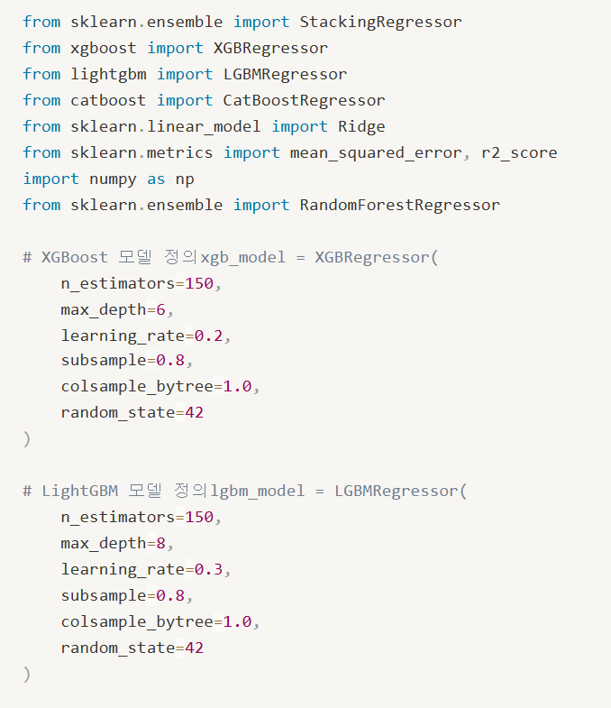
PART 4 Our Model
Part 1
03. 나현’s XGBoost
연구 개요
3
Model code
Hyperparameters found using Grid Seach

Slide 34
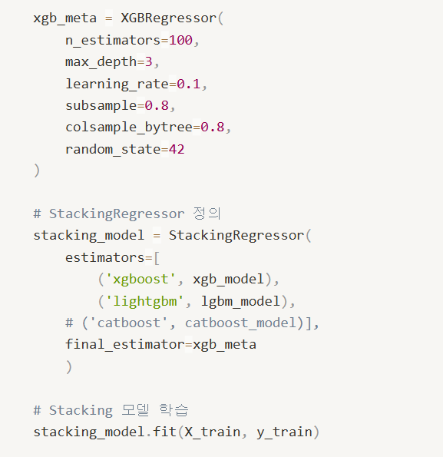
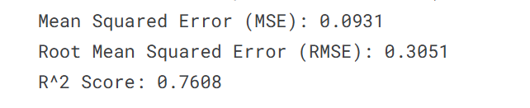
PART 4 Our Model
Part 1
03. 나현’s XGBoost
연구 개요
3
Results
Meta model: XGBoost
Hyperparameters have been simplified and used as much as possible.
Model Learning Results

Slide 35
PART
05
Conclusion
Public Score
Development
연구배경

Slide 36
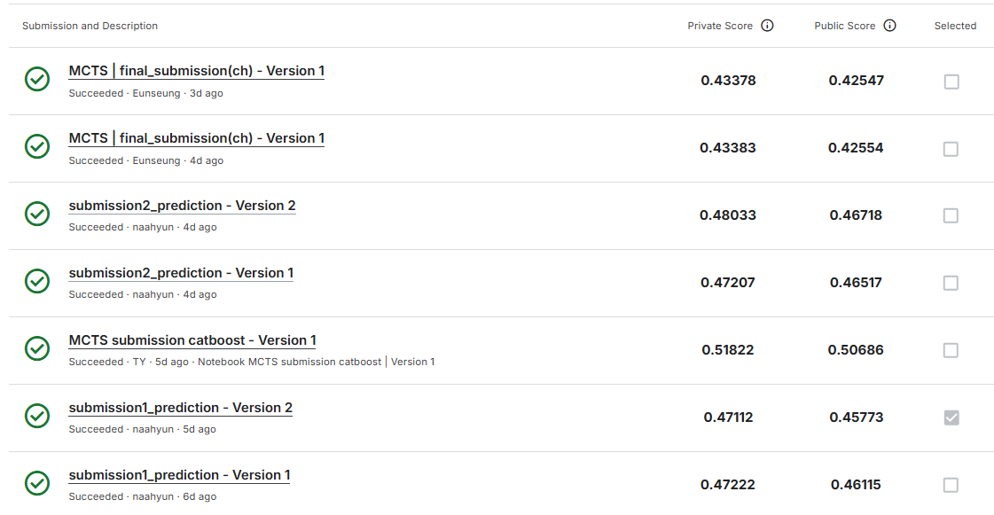
PART 5 Conclusion
Part 1
01. Public Score
연구 개요
1
Submission
We do a lot of submission and try to steadily increase the score.
Finally, We did
LightGBM + CatBoost

Slide 37
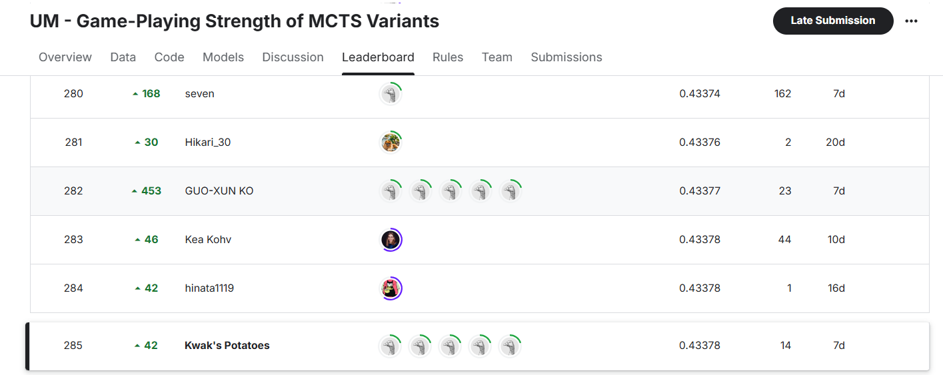
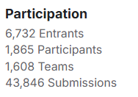
PART 5 Conclusion
Part 1
01. Public Score
연구 개요
1
Submission
285th out of 1608 teams

Slide 38
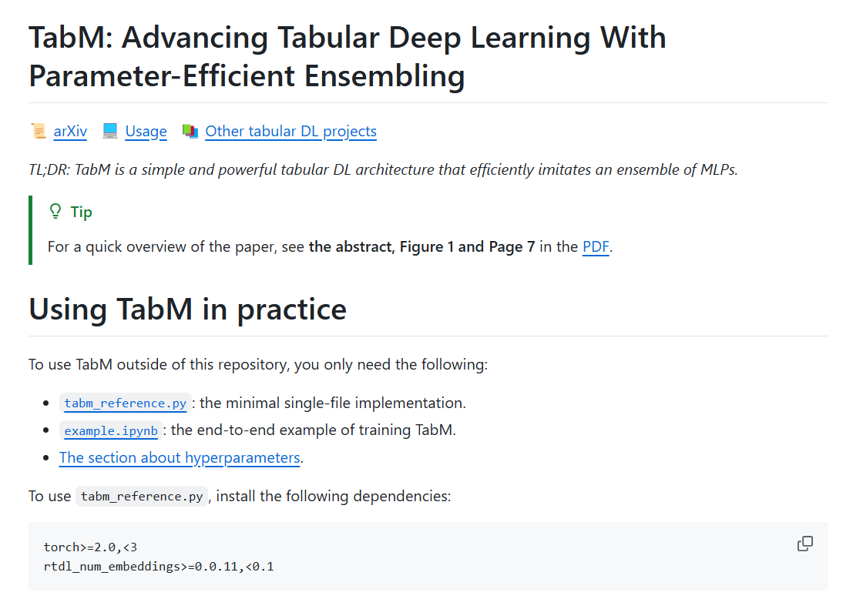
PART 5 Conclusion
Part 1
02. Development
연구 개요
1
1st place team usage model
Catboost + Deeplearning

Slide 39


PART 5 Conclusion
Part 1
03. At the end of the contest
연구 개요
1
Impression

Slide 40

Thank you for listening :)
연구배경
연구 목적 및 흐름도

